Slide 1
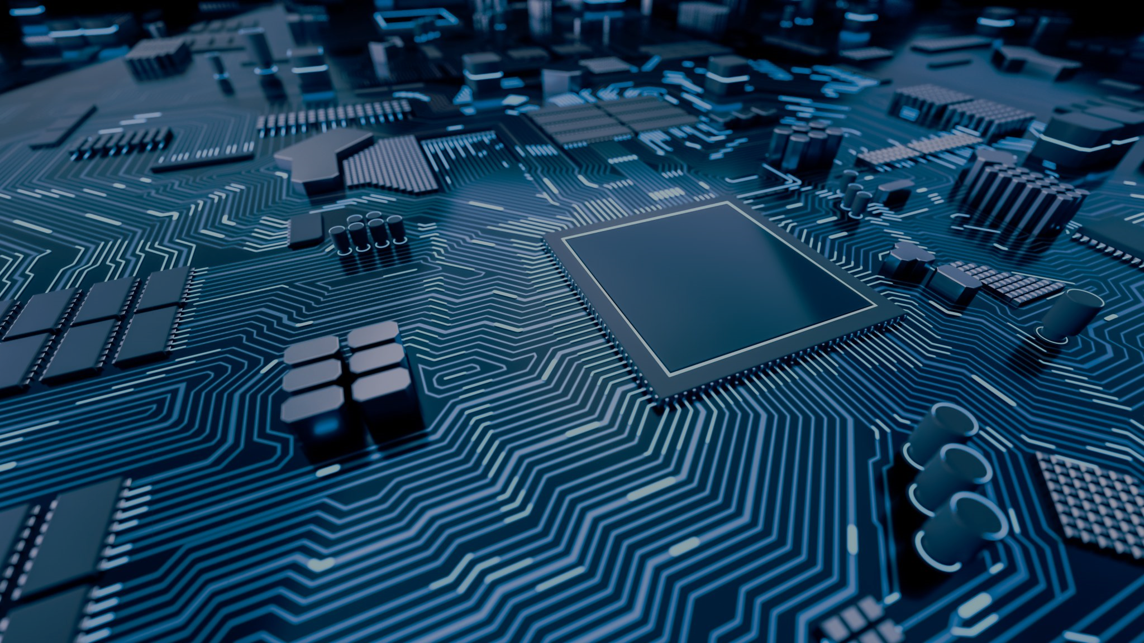
Neural Networks through Quantum Perspective
Mr. Faisal Sayed
Mr. Ashhar Shaikh
Mr. Faraz Shaikh
Guided by - Prof. Ahlam Ansari

Slide 2
ABSTRACT
Artificial neural networks, usually simply called neural networks, are computing systems vaguely inspired by the biological neural networks and they are widespread in both research and industry.
It is critical to design Quantum Neural Networks for complete quantum learning tasks. In this project we propose a computational neural network model based on principles of quantum mechanics which form a quantum feed forward neural networks capable of universal quantum computation.
The proposed project can be summarized by the following points given below:
The efficient training of the quantum neural network using the fidelity as a cost function, providing both classical and efficient quantum implementations.
Use of methods allows for fast optimization with reduced memory requirements.
Benchmarking our proposal for the quantum task of learning an unknown unitary and find remarkable generalization behavior and a striking robustness to noisy training data.

Slide 3
INTRODUCTION
The concept of artificial neural network has been proposed around 1950s mainly to mimic the different activities of human brain.
QNN has been developed combining the basics of ANN with quantum computation paradigm which is superior to the traditional ANN.
Quantum computers promise significant advantages over classical computers for a number of different applications.
We show that the complete loss function landscape of a neural network can be represented as the quantum state output by a quantum computer.
Moreover, application of QNN may also be seen in some of the related research papers. As such, this paper includes different models which have been developed and further the implement of the same in various applications. In order to understand the powerfulness of QNN, few results and reasons are incorporated to show that these new models are more useful and efficient than traditional ANN.

Slide 4
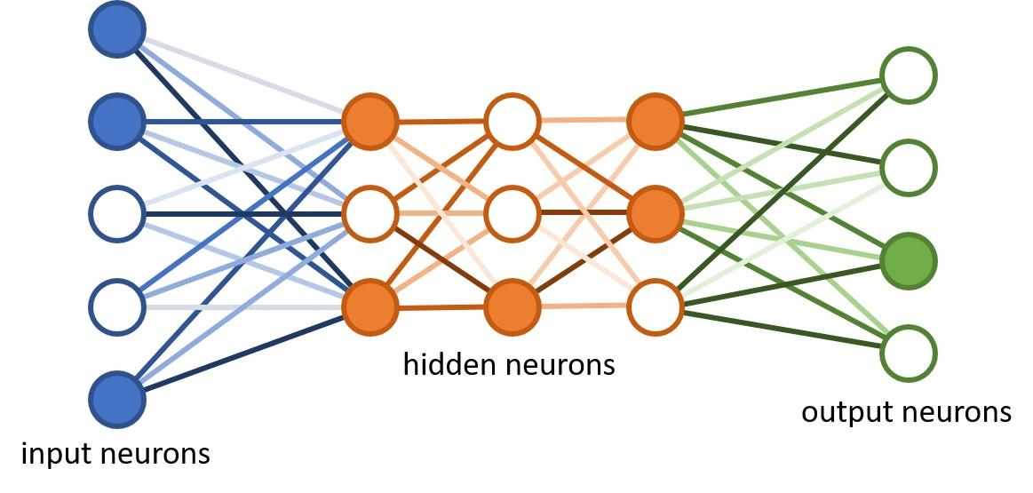
LITERATURE SURVEY
Quantum physicists have tried to come up with “quantum versions” of recurrent and feed-forward neural networks. The models were attempts to translate the modular structure as well as the nonlinear activation functions of neural networks into the language of quantum algorithms. However, one could argue that chains of linear and nonlinear computations are rather “unnatural” for quantum computers
More recent research has tackled this problem, suggesting special measurement schemes or modifications of the neural nets that make them more amenable to quantum computing, but the advantage of these models for machine learning is still not conclusively established.
2.1 – NEURAL NET ARCHITECHTURE

Slide 5
LIMITATION EXISTING SYSTEM OR RESEARCH GAP
It’s crucial to emphasize that it will probably be a long time before we have fault-tolerant quantum computers (having copies of qubit) for solving hard problems.
Nevertheless, we can make significant progress in the near term by developing better methods and hardware for implementing quantum error correction, guided by relatively small-scale experiments with quantum error-correcting codes.
In traditional neural networks arguably, the best-known disadvantage is their “black box” nature. Simply put, you don’t know how or why your NN came up with a certain output.

Slide 6
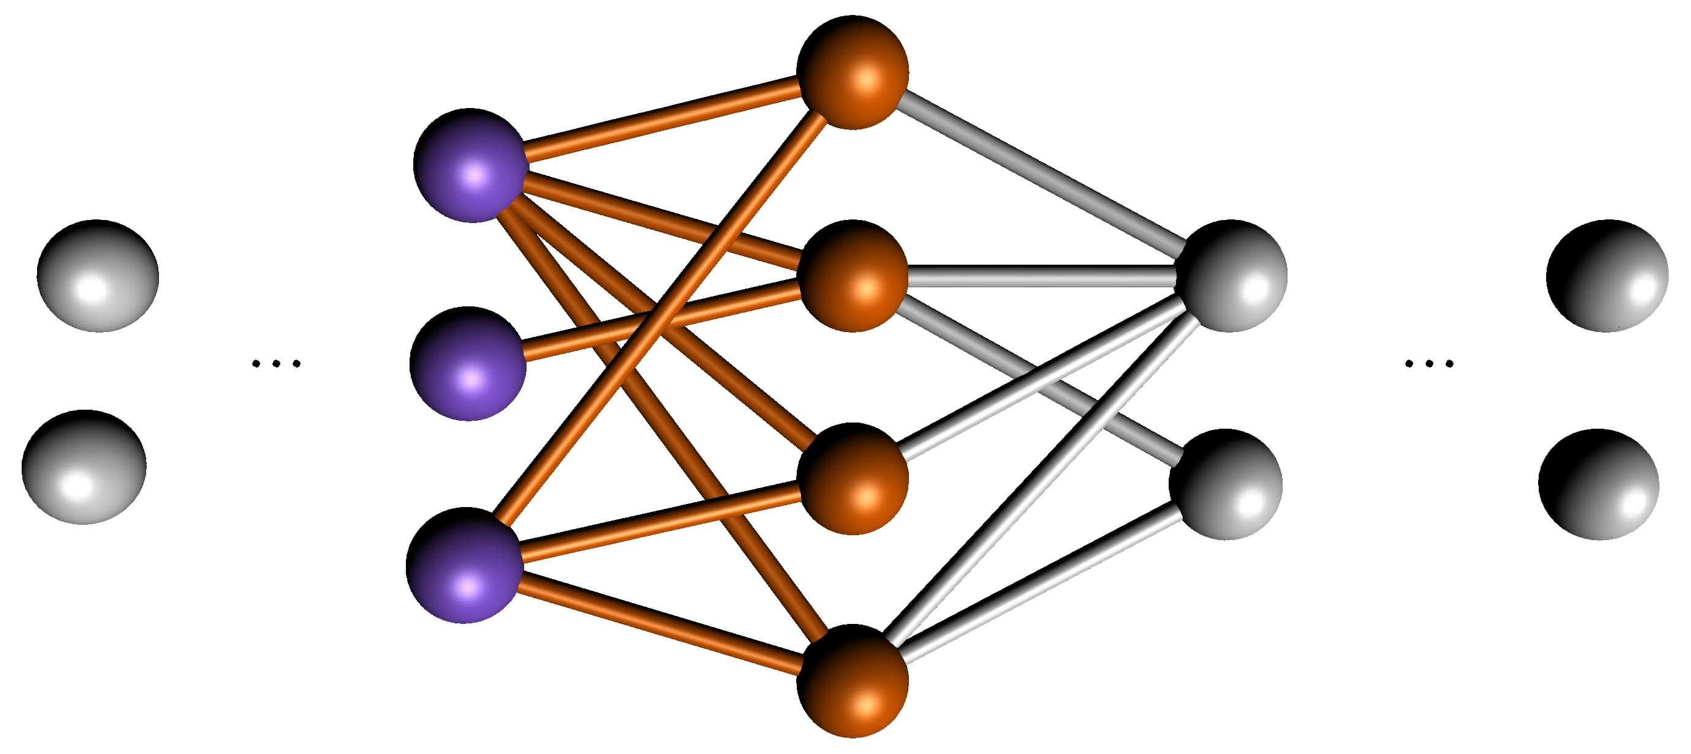
ALGORITHM – Feed Forward QNN
Initialize: Choose the initial Ul j randomly for all j and l.
Feedforward: For every training pair perform the following steps: 2a) Apply the channel Epsilon(l) to the output state of layer l − 1: Tensor
ρl−1(x) with layer l in state |0 . . . 0⟩l and apply U = Ul ml . . . Ul 1 2b) Trace out layer l − 1 and store ρl(x).
3. Update the network.
4. Repeat: Repeat step 2. and 3. until the cost function reaches its maximum. i.e 1.0
L-1
L+1
in
out
L

Slide 7

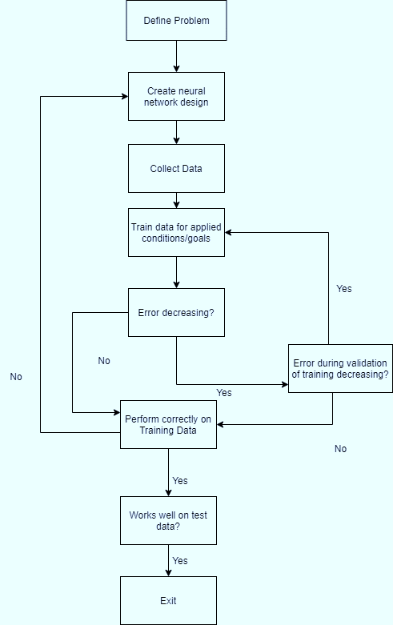
FLOWCHART
These two phases of operations are known as iteration. Neural Networks repeat the two steps until the desired output and accuracy is generated.
1. Training of networks: To train a network of data, we collect a large number of data and design a model that will learn the features. But the process is slower in case of a very large number of data.
2. Feature Extraction: After all the layers are trained about the features of the object, features are extracted from it and output is predicted with accuracy.
3. Evaluate Network: Once the network is trained, it can be evaluated.The network
can be evaluated on the training data, but this will not provide a useful indication of the performance of the network as a predictive model, as it has seen all of this data
before.

Slide 8
COMPARISON: ANN vs QNN
Advantages of quantum neural networks (QNN) as compared to the classical ANN, from which few of them are listed below
• Quantum parallelism.
• Memory capacity increased exponentially as compared to classical counterpart
• Capacity to learn is faster as compared to traditional one;
• Higher and good stability and reliability;
• Performance is high with less number of hidden neurons;
• Single layer network solution of linearly inseparable problems;
• Information processing speed is high;

Slide 9
DETAILS OF HARDWARE & SOFTWARE
Hardware Requirements
IBM Quantum Computer – 16 GB RAM
3.2.2 Software Requirements
Language – Python 3.x Python
Technologies used:
Numpy, Scipy
Qutip
Matplotlib
Jupyter Notebooks

Slide 10
SUMMARY
The cost function takes a slightly more complicated form when the training data output states are not pure, which may occur if we were to train our network to learn a quantum channel. The cost function varies between 0 (worst) and 1 (best).
To summarize the project here the prime objectives:
➢ To minimize cost function for QNN.
➢ Achieve generalization of Quantum neural network against noisy (random) pairs and evaluate corresponding cost function for it.
➢ Once generalized, check the robustness of QNN to noisy data.

Slide 11
CONCLUSION
The network architecture enables a reduction in the number of coherent qubits required to store the intermediate states needed to evaluate a QNN. Thus we only need to store a number of qubits scaling with the width of the network. This remarkable reduction does come at a price, namely, we require multiple evaluations of the network to estimate the derivative of the cost function.
In this paper we have introduced natural quantum generalizations of perceptron and (deep) neural networks, and proposed an efficient quantum training algorithm.
The resulting QML algorithm, when applied to our QNNs, demonstrates remarkable capabilities, including, the ability to generalize, tolerance to noisy training data, and an absence of a barren plateau in the cost function landscape.
There are many natural questions remaining in the study of QNNs including generalizing the quantum perceptron definition further to cover general CP maps (thus incorporating a better model for decoherence processes), studying the effects of overfitting, and optimized implementation on the next generation of NISQ devices.( 'Noisy Intermediate-Scale Quantum' devices)

Slide 12
THANK YOU

